Slide 1
Capacity Building Support Grant
September 10, 2025

Slide 2
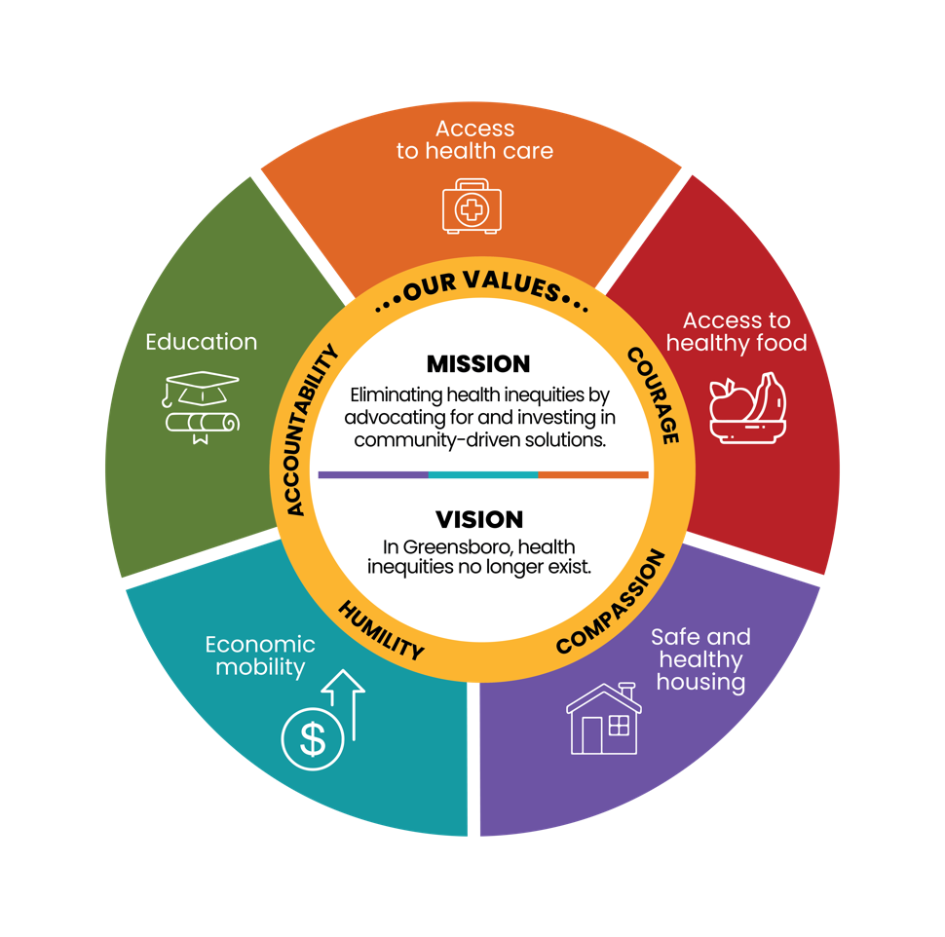
The Opportunity: Capacity Building Support Grant
This capacity building grant will support strategically aligned community-based organizations primarily serving the Greensboro area.
We want to partner with organizations working to address systemic health inequities by impacting the social and environmental factors that drive health equity in the following priority areas:
Healthy food
Education
Safe and healthy housing
Economic mobility

Slide 3
Capacity Building: What It Is vs. What It Is Not
Focus Area | Capacity Building Is | Capacity Building Is Not
Leadership Development & Staff Training | Ongoing investment in leadership pipelines, coaching, and skill-building | One-off trainings without follow-up or integration
Advocacy & Policy Engagement | Building infrastructure and strategy for sustained policy influence | Short-term advocacy without long-term capacity
Internal Operations (Finance, Legal, HR, IT) | Strengthening systems and internal knowledge for efficiency and compliance | Outsourcing tasks without internal improvements
Strategic Planning & Goal Setting | Facilitating long-term vision, alignment, and measurable goals | Creating plans that are not implemented or revisited
Research, Evaluation & Learning | Developing tools for continuous learning and data-informed decisions | Collecting data only for funder compliance
Brand, Messaging & Communications | Enhancing identity and storytelling to build visibility and support | Promoting a single event without broader strategy
Partnerships & Collaboration | Building strategic, mission-aligned relationships and shared frameworks | Attending events without cultivating long-term partnerships

Slide 4
Who Should Apply?
Capacity building support is intended for partners whose work can be strengthened and sustained, enabling them to scale their efforts to influence systems-level change and amplify their overall impact.
Open to nonprofits, community-based organizations, coalitions, and other community groups in Greensboro.
Small-to-mid-sized organizations ($500,000 or less)

Slide 5
Timeline of Application Process
Application Opens
8/25/25
Deadline to Apply
9/19/25
Application Review
October –December
Award Notification
December
Grant Period
January 2026-December 2026

Slide 6
Anticipated Grant Amounts
Grant awards range: $0 - $20,000
Based on scope and need of proposal
Flexible funding to support meaningful capacity building investments

Slide 7
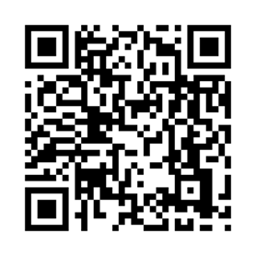
Q&A
Sign up for e-newsletter for updates and future opportunities
If you have further questions, please contact our Finance and Grants Manager, Luke Wallace, luke.wallace@conehealth.com

